Slide 1


Slide 2


Slide 3
Economy/Market Key Points
Economy
Inflation
Iran/Oil
Investing through uncertainty

Slide 4
Economy/Market Key Points
Economy – Slightly slower growth but still positive with upside
Inflation – Oil will not cause long-term inflation spike
Iran/Oil – Higher oil = relatively better for US
Investing through uncertainty – There has always been something to worry about

Slide 5
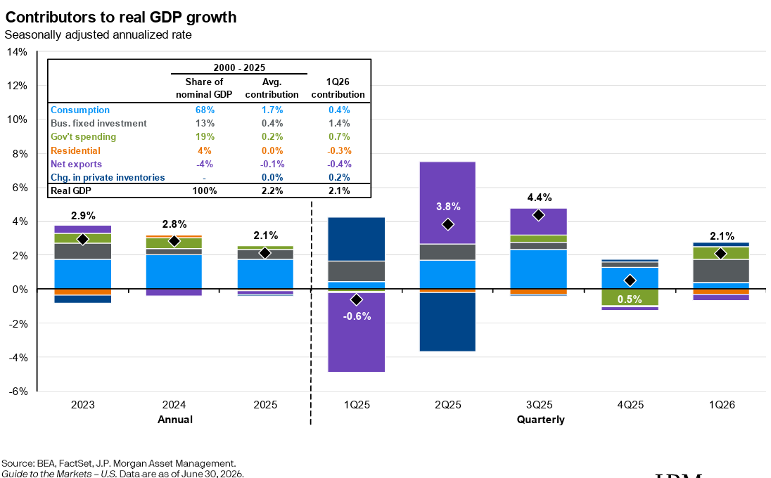
Economy is solid w/upside potential
Consumer is spending
Trade volatility is over
Business investment upside potential
Rates are a headwind

Slide 6
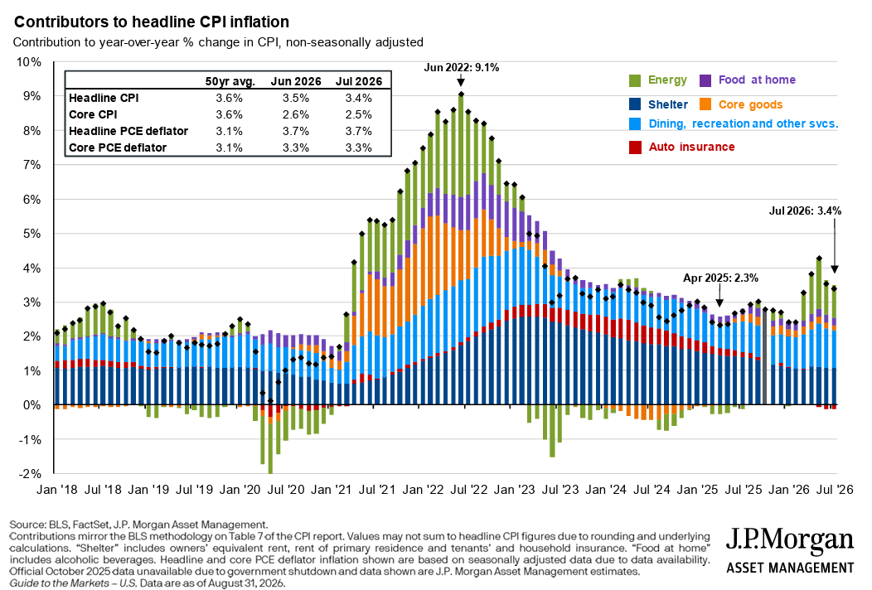
Inflation – Shelter is what matters

Slide 7
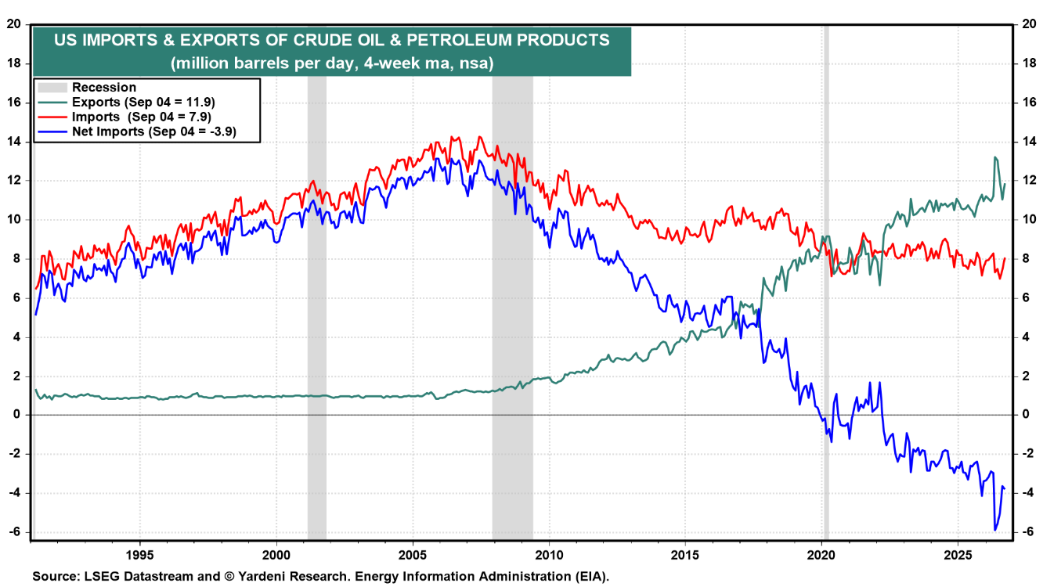
US wins with higher oil

Slide 8
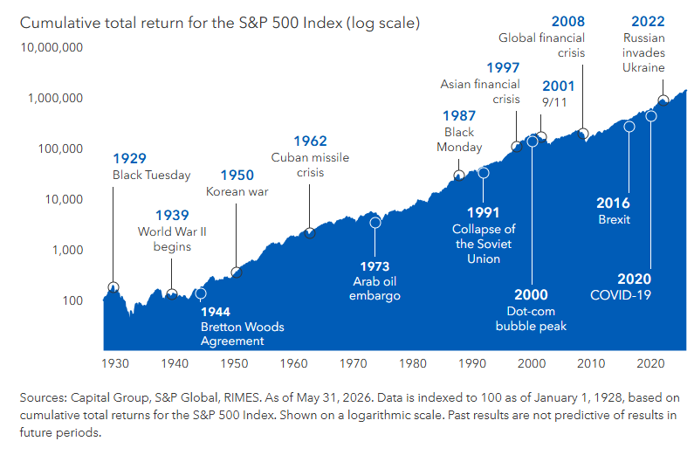
Investing in Uncertainty

Slide 9


Slide 10

RAISING THE STANDARD
CONSISTENCY
A standardized planning process, so every client gets the same high level of service
EFFICIENCY
Using AI to handle the busywork, freeing more of our time for you
THE HUMAN ELEMENT
Keeping the focus on what matters most to you and the relationships behind the plan
Notes:
Introduce myself. Speak to the efforts we are making to raise our overall level of planning and service, utilizing AI for enhanced efficiency while focusing on what matters most to our clients and the human aspect of planning.

Slide 11
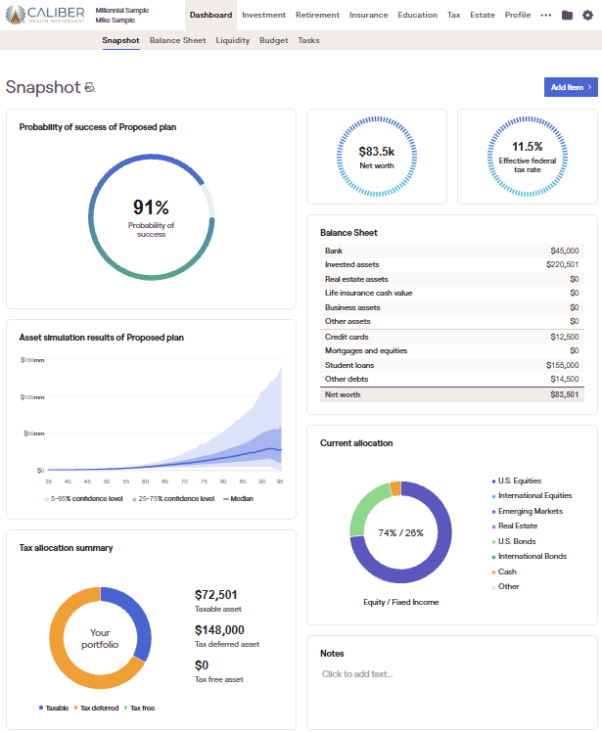
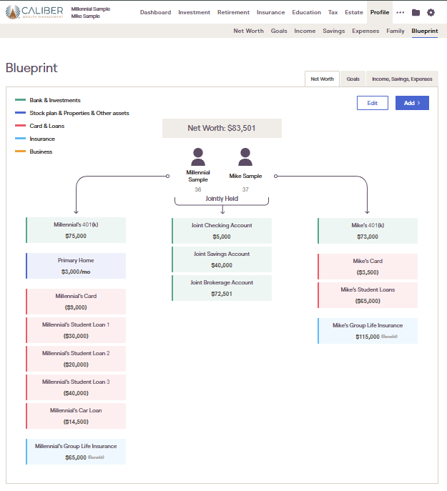
RIGHTCAPITAL
New planning software, firmwide by year end
Enhanced planning capabilities
Integrates with Jump, Advyzon and our other tools
One comprehensive look at your entire financial picture
Notes:
To that end, we are adopting new planning software firmwide by year end with enhanced capabilities. Show a screenshot of the tool. Talk about its integration with our other tools (Jump, Advyzon, etc.), making it easier than ever for us to have one comprehensive look at their entire picture.

Slide 12

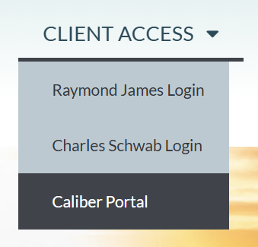

CLIENT PORTAL
Rolled out last year
Replaces or supplements logging in to custodians directly
Another example of our independence: not tied too closely to any one institution
One-stop access to all of your accounts
Notes:
As a reminder, we rolled this out last year, and it can replace or supplement logging into custodians directly. Another example of our independence and not being tied too closely to other institutions. One-stop portal with links to Schwab, Raymond James and RightCapital.

Slide 13


STAY CONNECTED!
Firm news, market updates, and planning tips, all in one place.
Please follow us on all platforms!
Notes:
Promote our social media channels and ask everyone to follow us on all platforms.

Slide 14


Slide 15
Medicare UPDATE 2026 / 2027
The Good News and Not so Good News
Medicare Part D Prescription Drug Coverage
and
Part C Medicare Advantage plans
will have CHANGES Effective
1/1/2027

Slide 16
What Is Medicare?
Federal Health Program for people:
  65 and older
  Under 65 with certain disabilities
  Any age with End-Stage Renal Disease
  Original Medicare Parts A and B were signed into Law on July 30, 1965, under Lyndon Johnson.
Notes:
Lyndon Johnson signed the Medicare and Medicaid programs into law on July 30, 1965. Medicaid became effective January 1, 1966, and Medicare became effective July 1, 1966. Medicare is the nation’s largest health insurance program, currently covering about 72 million Americans.
Medicare is health insurance for three groups of people:
People who are 65 and older.
People under 65 with certain disabilities who have been entitled to Social Security disability or Railroad Retirement Board benefits for 24 months.
The 24-month Medicare waiting period does not apply to people disabled by Amyotrophic Lateral Sclerosis (ALS, known as Lou Gehrig’s disease). People with ALS get Medicare the first month they are entitled to disability benefits. This provision became effective on July 1, 2001.
People of any age who have End-Stage Renal Disease, permanent kidney failure requiring dialysis, or a kidney transplant.

Slide 17
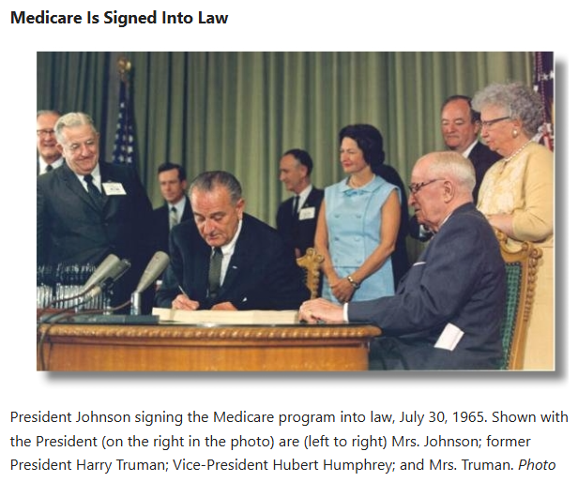
President Harry Truman and Wife Bess are Medicare Enrollees #1 and 2 in 1965

Slide 18
Who Runs Medicare?
Centers for Medicare & Medicaid Services – CMS
CMS also operates Medicaid and
The Affordable Care Act – Individual Health plans
Robert Kennedy Jr. is Secretary of the Department of Health and Human Services
Dr. Oz in Head of Medicare/Medcaid
Services - CMS
You Enroll via the Social Security Administration
Notes:
Your gateway / doorway to access Medicare is through the Social Security Administration

Slide 19

FIRST BABY BOOMER – Kathleen Kirschling
Born 1 second past Midnight Jan. 1, 1946
1st Boomer to file for Soc Sec Benefits October 2007
1st Boomer to file for Medicare October 2010
1946 to 1965 20-year span where
80 million Baby’s were born after WW II.
RIGHT NOW Aprox. 14,000 PEOPLE A DAY TURNING AGE 65 until 2030.
Current aprox. 70 mil in Medicare by 2030 Could be nearly 80,000,000 WOW!!

Slide 20
The Four Parts of Medicare
Part A Hospital Insurance
Part B Medical Insurance
Part C Medicare Advantage Plans (like HMOs/PPOs) Includes Part A, Part B, and sometimes Part D coverage
Part D Medicare Prescription Drug Coverage
Notes:
Part A (Hospital Insurance) helps pay for inpatient hospital stays, skilled nursing facility care, home health care, and hospice care.
Part B (Medical Insurance) – Doctors Office Insurance – Primary Care & Specialists
**Together, Part A and Part B are known as “Original Medicare.”
Part C (Medicare Advantage (MA) –This is where all the noise and confusion is and all the mail and phone calls are for these - These are your network-based group health plans - Provided by private Health Insurance companies -- United Health Care, BCBS, Aetna, Humana, and Cigna.
Part D (Prescription Drug Coverage) helps pay for outpatient prescription drugs at pharmacy.

Slide 21
Monthly Part B Premium
IRMAA – Income Related Medicare Adjustment Amount / part of ACA
You pay more for Part B and Part D based on Income
If your yearly income in 2024 was |  | In 2026, each month you pay
File Individual Tax Return | File Joint Tax Return | Part B / Part D
$109,000 or less | $218,000 or less | $202.90 / N/A
$109,001 – $137,000 | $218,001 – $274,000 | $284.10+14.50 = $298.60
$137,001 – $171,000 | $274,001 – $342,000 | $405.80+37.50 = $443.30
$171,001 – $205,000 | $342,001 – $410,000 | $527.50+60.40=$587.90
$205,001 - $500,000 Above $500,001 | $410,001 - $750,000 Above $750,001 | $649.20+83.30=$732.50 $689.90+91.00=$780.90
Note: Premiums can be deducted from your Social Security benefit payment or if you are not taking Soc Sec, you are billed quarterly or can have a Monthly Automatic Bank Deduction.
Notes:
Because Part B is really the BULK of your Insurance it costs a monthly premium.
-They have a 2 year Look Back at your AGI on Tax Return
-IF you file Individual you’ll look at Left Column – If you file Jointly with a Spouse you’re the middle column.
-IF you’re AGI on your Tax Return is $212,000 OR LESS in 2023 – Pay base Premium of $185/month.
--However, if you’re income was HIGHER and lets say it was $250,000 – Then you’ll receive and IRMAA LOAD – Income Related Medicare Adjustment Amount
--So Now your Part B will increase to $259/month, but they ALSO charge you a premium for Part D as well f $13.70/month
--TOTAL PREMIUM PER MONTH $272.70
**YOU CAN APPEAL the IRMAA Load for certain reasons, MOST POPULAR is RETIREMENT
--You have to fill out a form and drop it off at your local SSA Office. We can provide you with this document.

Slide 22
Medicare Part B
What are your Costs?
In Original Medicare Part B you pay
  Yearly deductible of $283 in 2026
  A & B only covers 80% of the bill
  20% Coinsurance
  →No Maximum Out of Pocket Limit

Slide 23
What Is a Medigap/Medicare Supplement Policy?
Medicare Supplement Insurance Policies
  Provided by Life and Health Ins Companies
Fills Gaps in Original Medicare Part A & B
  Deductibles, Coinsurance, Copayments
There is a Monthly Premium
There are up to 8 different plans to choose
  Each of the lettered plans have same health coverage no matter what Insurance Company
  Premiums very by Insurance Company

Slide 24
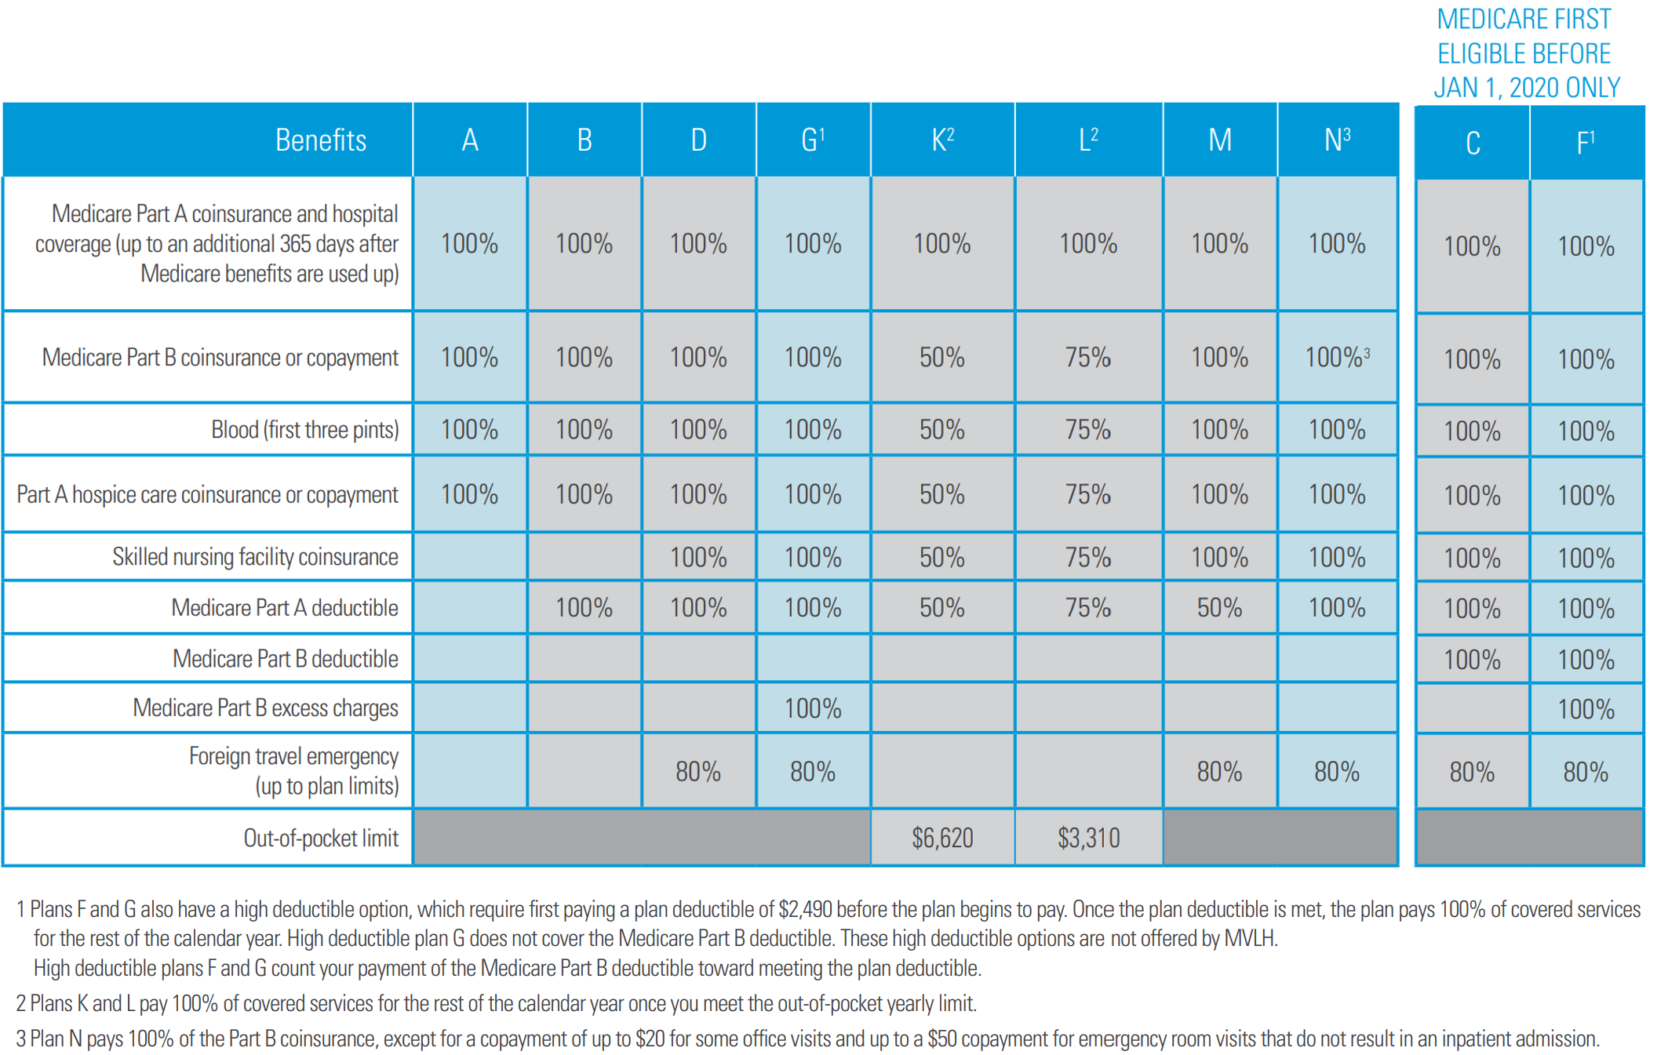
Medicare Supplement Options 2021

Slide 25

Medicare Part D - Prescription Drug
Part D Covers:
  Covers Prescription Medications
  Most Plans have a monthly premium
  5 tier Drug formulary
  You pay Copays or Coinsurance on your Prescriptions
  Maximum Out-of-Pocket $2100 in 2026
  Going to $2400 in 2027
  Most Plans have a deductible up to $615 in 2026/ $700 in 2027 – only applies to Tier 3, 4 & 5 Drugs. However some plans are applying the Deductible to ALL Tiers in 2027
  2026 All Top Brand Drugs are reducing Prices
  NEW TrumpRx website
Notes:
-IF you take inexpensive generic drugs like statins & blood pressures -- $0 Premium Plan and then just have small $2-$5 co-pays when you fill the medications.
-However, if you have any expensive drugs, I call then the TV Commercial drugs – then you might be on a $20 or $30 a month plan to help cover those most expensive drugs.
-How you choose Part D is all based on the prescriptions that you take.
-We probably spend the most time helping someone with Part D, especially if they have quite a few prescriptions because it can be very confusing
-Have a great system where we input all drugs and it tells us down the PENNY what you’ll pay in a 12month period for all your drugs.
***SO the 4 pieces I just described, Medicare PART A for Hospital Coverage, PART B for Doctors Office that covers 80% of the bill – The Supplement Plan G covers the other 20%, and Part D covers are your prescription drugs at the pharmacy. These 4 pieces combined are what build your package to get you 100% coverage at the Hospital, Doctor, Pharmacy….
**YOU’RE ALTERNATIVE or OPTION #2 on how you receive your Medicare…..

Slide 26
Medicare Parts C – Advantage Plan
Plans are Provided by Health Insurance Company’s, and your Benefits are Paid by the Health Companys vs Medicare.
Plans are Network Based PPO or HMO vs Original Medicare A&B does not have Networks
  • Covers All Benefits & Services of Original Parts A and B
  • Includes Part D Prescription Drug Coverage at NO premium
  • Plans do Not have a front-end Deductible, but have Copays & Coinsurance up to a Max. Annual Limit
  Plans include extra Benefits at No Cost – Dental, Vision, Hearing, Health Club Membership, Additional Non-Prescription allowance OTC, Meals after Hospital stay.
Notes:
YOUR ALTERNATIVE or OPTION #2 on how you receive your Medicare is the Part C or better known as ADVANTAGE PLANS.
-By Law have to cover all the benefits that Original Medicare Part A & B covers, but it also INCLUDES Part D at NO additional COST.
-These plans operate and feel exactly like your employer Plan…
-They’re offered by the Private Insurance companies like: HUMANA, UHC, AETNA.
-They’re NETWORK BASED PLANS – Big Broad PPO Network where you can go to see in and out of network doctors. But some plans have HMO networks, that are smaller.
-You pay Co-pays when you USE the Plan at the DOCTOR and HOSPITAL.
-EXAMPLE: Cardiologist $35 co-pay, Blood work $50 co pay, Ambulance Ride $300 co-pay.
*ALL CO-PAYS stack UP to a MAX OUT OF POCKET per year – on average $4000 in KC metro area.
--BIGGEST MOST ENTICING THING about Advantage Plans is that they’re $0 monthly premium – they don’t cost you anything in addition to your Part B monthly premium.
--They also all include added benefits such as Full Dental $2000 + annual cleaning, Vision to go get eyes checked and new glasses, $3000 towards hearing aides, FREE GYM called Silver Sneakers, some include an OTC card to go buy things like vitamins, bandaids, toothbrushes.

Slide 27
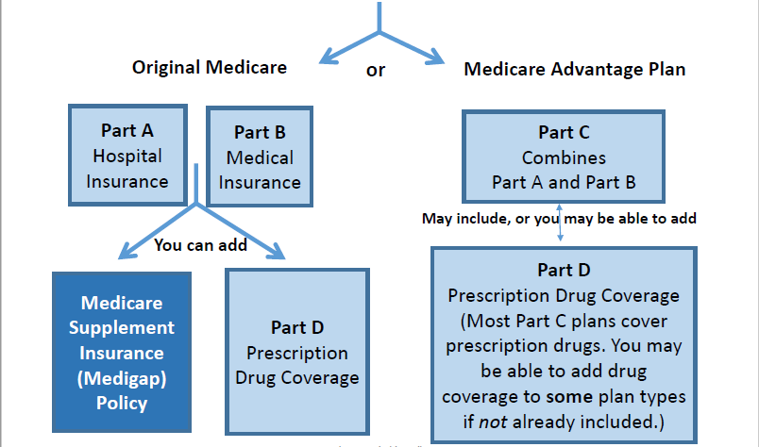
You Decide which Way to get your Medicare Coverage –
You Must have both Part A and B and you pay a monthly premium for Part B whether Left or Right
Very Comprehensive Health Care. Pay fixed
premiums every month for Supplemental
and Drug plans. No Value-Added options
Very Good Health Care. $0 Premium.
Includes many Valued Added Benefits.
Dental, Vision, Health Club, OTC allowance
Notes:
---TO bring it all together, This is your road map to Medicare.
--When you Join Medicare you have 2 options
--OPTION #1:
LEFT Side to Original Medicare A&B –
VERY Comprehensive Coverage –
Universe of Providers is EVERY hospital in America. SO- Every hospital in KC and even MAYOs Clinic, MD Andersen.
PART B – Very comprehensive coverage at your doctors office, emergency room, urgent care.
98% of all doctors in America..
BUT A&B only covers 80% of the bill. You’re left with 20% Co-Insurance and there’s no limit to that.
And in today’s healthcare world – We can’t have that type of out of pocket exposure.
So that’s where we add a Medicare Supp /Medigap Insurance Policy to cover that 20% exposure.
This will follow you around to any hospital under Part A – and to the doctors office under Part B and it will pay that 20% Co-Insurance.
The only thing it won’t cover is a 1 time yearly deductible of $257.
The Last Piece – Part D – Pharmacy Coverage
The LEFT SIDE: Gets you Freedom of choice of Doctors/Hospitals, no Pre-auths, preapprovals, Its Set it and Forget it – 100% Coverage.
The Best it gets in America today.
Okay SO NOW THE RIGHT side : Option 2 – Part C Medicare Advantage Plan – This is the private ins option under Medicare.
Operates A LOT like your current employer plan does with networks and copays when you use the plan.
Provided by Private Insurance Companies Aetna, UHC, Humana
Has a Annual Max out of Pocket – In KC Area around $4000 on average
By Federal Law - It Has to cover everything Part A&B covers and INCLUDES Part D at no extra Premium.
These plans are VERY enticing and ADVANTAGEOUSE because they are $0 monthly premium.
TONS of Addition benefits that you DON’T get under Original Medicare:
Routine Dental, Vision, Hearing Exams at NO COST – Original Medicare DOES NOT COVER these…
OTC allowance, $60 a quarter for bandaids, vitamins, aspirins.
Has a Gym Membership
So you might say Gosh This Advantage plan sounds great with all these added benefits, I’m healthy today, I’ll save about all that money in monthly Premiums and can’t I just down the road change over to Original Medicare during the AEP…??
WELLL yes, you can disenroll from your Medicare Advantage Plan
Pull A&B to the front and then APPLY for that Supplement…
KEY WORD is APPLY - because remember that Supplement is only open 1 time in your Medicare life NO QUESTIONS asked and is now closed….
That’s the REST OF THE STORY that you don’t always hear -- now have to APPLY for that supplement and they can deny you based on health history.
And you don’t want to go to ONLY A&B without that Supplement because you’ll have that 20% UNLIMITED exposure
The right side of the chart is Managed healthcare, it’s a Network based PPO/HMO – You don’t have 100% of all hospitals and 98% of all doctors. There’s pre-authorizations…
The Insurance company dictates where you go and what services you can get done.
These plans are $0 monthly premium, BUT you will pay for the plan as you use IT up to your MAX Out of Pocket limit.

Slide 28
Medicare Enrollment Periods
  Initial Enrollment Period IEP
This is the 7-month period when you are aging to 65.
It is 3 months before 65, the month you turn 65 and 3 months after a
  Special Enrollment Period SEP
  Work beyond age 65 and leave Employer Group Coverage whether Employee coverage or coverage as a Dependent.
  **NOTE: You do not have to leave employment
Annual Enrollment Period AEP
Occurs every year between Oct 15 to Dec 7
      Coverage begins January 1
ONLY Applies to: Changing Part D Prescription Drug Plans
Part C Medicare Advantage Plans
Notes:
Our Federal Government LOVES ACRONYMS –Hey if they made it EASY you wouldn’t need us! So The ACRONYM SOUP of Medicare Enrollment Periods are:
IEP – This is the first time you can enroll in Medicare – Your Initial Enrollment Period – This is a 7 month period.
It will start on the 1st day of your birthday month.

Slide 29
HSA Contribution Limits 2026
HSA account holders can choose to save up to $4,400 Individual and $8,750 for a Family.
Amounts are payroll deducted before tax
HSA can be used to pay for Medicare B & D Premiums, out-of-pocket expenses for Deductibles, Copays, Coinsurance.
HSA $ can be used for Deductible & Co-Pays for Dental, Vision, Hearing Aids, LTC Policy premiums etc.
Note: Premiums that are not an eligible expense – Medicare Supplements, Dental and Vision.
Notes:
**Do I need to say something about not being able to contribute to an HSA once you start Medicare??**
Great Financial Vehicle

Slide 30
Medicare UPDATE 2026 / 2027
The Good News and Not so Good News
INFLATION
Average Health Cost increase in 2026
15% to 18%
No Relief in sight for 2027
Overall Medicare Utilization has increased Considerably – Baby Boomers are having Claims – Joint Replacements #1 Procedure People wait until Medicare to have done
Supplemental Plans are averaging annual premium increases on low side 15% to as high as 30% in 2026. 2027 could be higher % increases
Advantage plans increasing CoPays and Annual Out of Pocket Maximums. Reducing Supplemental Benefits Coverage on
Dental , Vision, Hearing, OTC benefits
Many plans are moving away from PPO to more restricted HMO Networks

Slide 31
Medicare Part D UPDATE 2026 / 2027
GOOD NEWS ! !
Trump tells Pharmaceutical Companys to abide by Fair Nations Trading Act by start of Medicare Annual Enrollment Period 10/1/2026
Drugs prices have reduced considerably in some cases
3 to 4 times lower
NEW Annual Cap on Copays (includes $700 Ded) of
$2100 in 2026 and $2400 in 2027
Insulin related Medications $35 Copay Maximum
NEW GLP Bridge program for Medicare Eligible - $50 per month if you want to try Ozempic or Mounjaro or Zepbound for Weight Loss ONLY

Slide 32
Medicare Part D UPDATE 2026 / 2027
NOT SO GOOD NEWS
CMS Shifting Majority of Part D Drug plan subsidies to Insurance Plans effective 1/1/27 – previously CMS Subsidized 70 to 75 % of Annual cost of Part D plans
1/1/27 – Insurance Plans now responsible for 70% of Part D costs.
CMS’s portion will be 15% and Pharmacetical Company’s 15%.
As a Result – 1/1/2027 plans will
Have MUCH Higher Premiums – UHC $265 per month,
Aetna going to $125, BCBS of KS $0 premium plan going to
$45 per month, Humana significant increase
Many plans will also change their Formulary’s and Tiers – Many plans the $700 Deductible will apply to ALL level of Drugs even Generics
Some plans are reducing the Area’s / States they will market plans to in 2027

Slide 33
Medicare Part D Drug and Advantage Plans
UPDATE 2026 / 2027
All plans are required to send you by 9/30 of each year
The Plans Annual Notice of Changes for the next year
ANOC
IMPORTANT - READ THIS TO UNDERSTAND HOW YOUR PLAN IS CHANGING FOR THE NEXT YEAR.
Medicare allows you to change your Part D Drug plan or Part C Advantage plan to another plan during the period 10/15 to 12/7 for a 1/1 effective date.

Slide 34

Thank You
Sam George
Principal
sam@mdprs.com
913-634-4233
Amanda Sharp
Medicare Advisor
amanda@mdprs.com
913-548-6993
Grant George
Medicare Advisor
grant@mdprs.com
913-634-5268
Nick Lemos
Medicare Advisor
nick@mdprs.com
913-404-8990
We Do Not Charge Any Fees for Our Services
Notes:
Medicaid is a program that helps pay medical costs for some people with limited income and resources. Medicaid is jointly funded by the Federal and state governments and is administered by each state. It can cover pregnant women and children; aged, blind, and disabled people; and some other groups, depending on the state.
If you’re eligible for both Medicare and Medicaid, most of your health care costs are covered; we sometimes refer to these people as “dually eligible.” People with both Medicare and Medicaid get drug coverage from Medicare, not Medicaid. People with Medicaid may get coverage for services that aren’t fully covered by Medicare, such as nursing home care and home health care.
Medicaid eligibility is determined by each state, and Medicaid application processes and benefits vary from state to state. You should contact your state Medical Assistance office to see if you qualify.
You should apply if you think you MIGHT qualify. For more information or to apply, you can:
Get the phone number by visiting medicare.gov/contacts or by calling 1-800-MEDICARE (1-800-633-4227). TTY users should call 1-877-486-2048 (medicaid.gov).
Call your State Health Insurance Assistance Program.
Call or visit your state Medical Assistance office.

Slide 35


